Slide 1
Recap and moving on …
Recap
How analysis of a phase diagram starts with the Clapeyron equation
Multiple ways of thinking about the liquid-vapor phase boundary
How we separated variables in Clapeyron to get Thomson and Clausius-Clapeyron
Moving on
Let’s integrate the Clapeyron for the three phase boundaries
Implement them in Python as a phase diagram of water

Slide 2
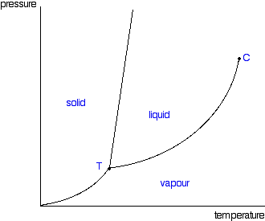
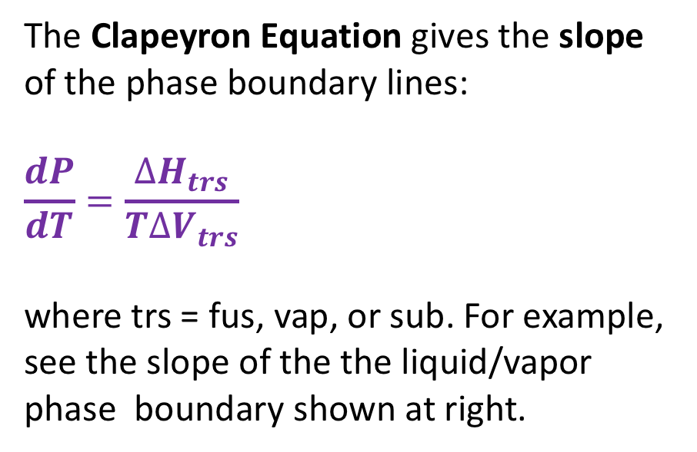

Recap: Clapeyron equation
The Clapeyron Equation gives the slope of the phase boundary lines:
$$\frac{dP}{dT}=\frac{∆H_{trs}}{T∆V_{trs}}$$
where trs = fus, vap, or sub. For example, see the slope of the the liquid/vapor phase boundary shown at right.
P
$$∆H_{vap}$$
$$∆V_{vap}$$
T

Slide 3
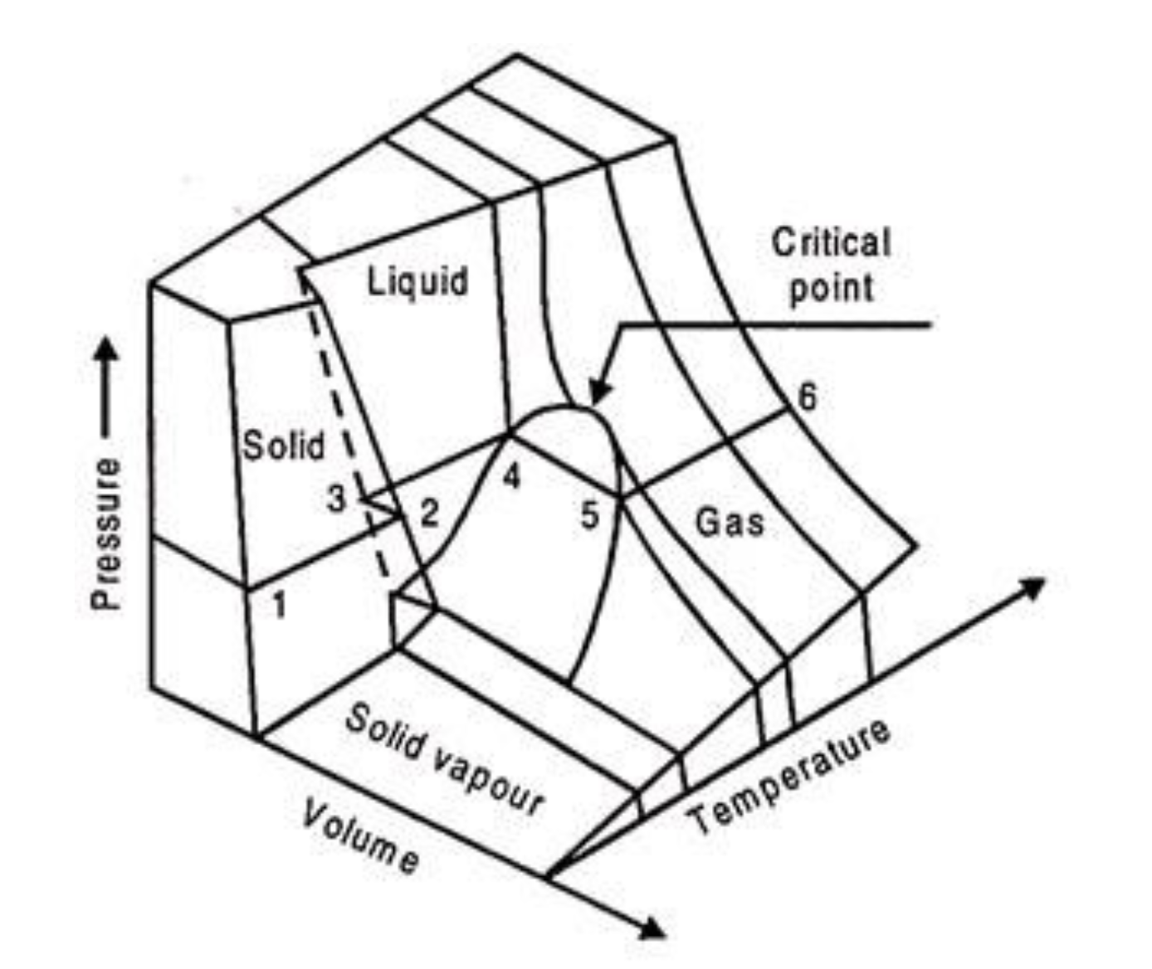
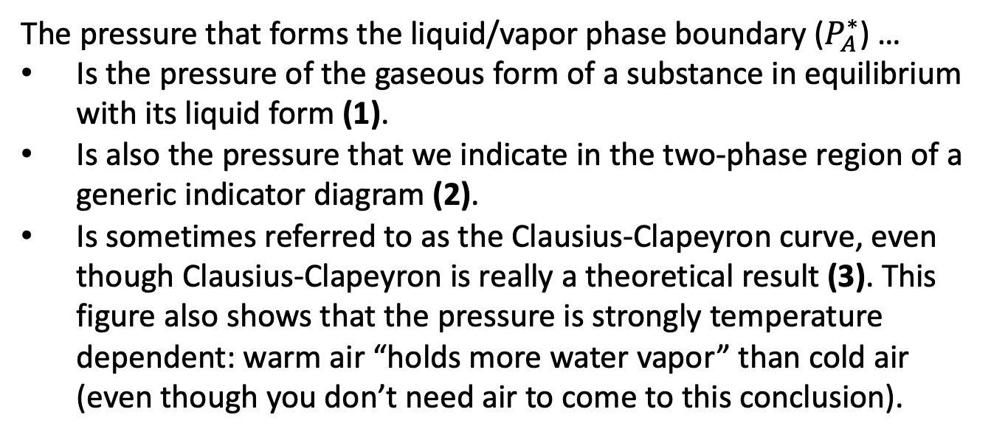


Recap: Multiple ways of thinking about the liquid-vapor phase boundary
The pressure that forms the liquid/vapor phase boundary ($P_{A}^{∗}$) …
Is the pressure of the gaseous form of a substance in equilibrium with its liquid form (1).
Is also the pressure that we indicate in the two-phase region of a generic indicator diagram (2).
Is sometimes referred to as the Clausius-Clapeyron curve, even though Clausius-Clapeyron is really a theoretical result (3). This figure also shows that the pressure is strongly temperature dependent: warm air “holds more water vapor” than cold air (even though you don’t need air to come to this conclusion).
A(g)
(1)
$P_{A}^{∗}$
A
A
A
A
A
A
Pure A(l)
A
A
Generic indicator diagram
P
(3)
(2)
$$P_{A}^{∗}(T)$$
T

Slide 4
Aside: Why Mars is icy, Earth has oceans, and Venus is crazy hot (a very tenuous explanation)
P
T
Mars
Venus
Earth

Slide 5
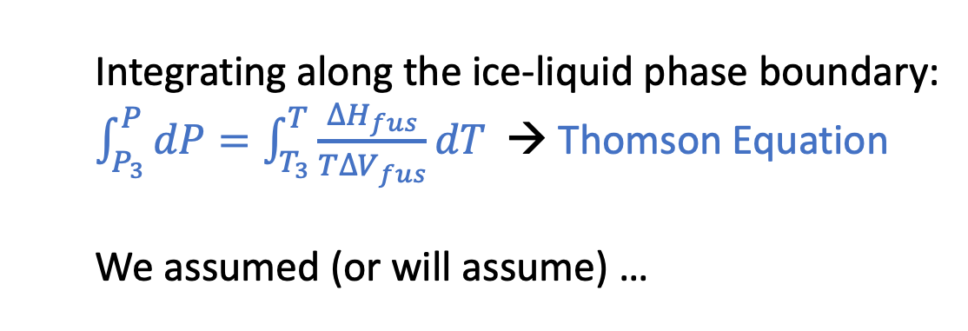
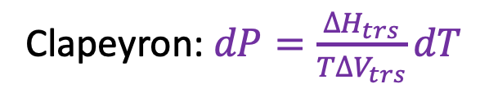
Separating variables in preparation for integrating Clapeyron
Clapeyron: $dP=\frac{∆H_{trs}}{T∆V_{trs}}dT$
P
Integrating along the ice-liquid phase boundary:
$\int_{P_{3}}^{P}{dP}=\int_{T_{3}}^{T}{\frac{∆H_{fus}}{T∆V_{fus}}dT}$ → Thomson Equation
We assumed (or will assume) …
T

Slide 6
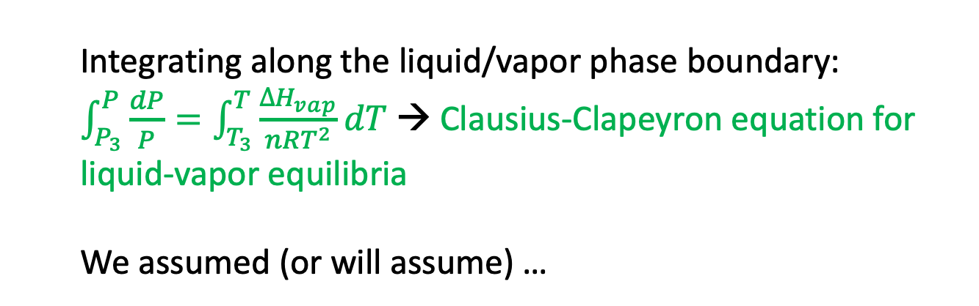
Separating variables in preparation for integrating Clapeyron
Clapeyron: $dP=\frac{∆H_{trs}}{T∆V_{trs}}dT$
P
Integrating along the liquid/vapor phase boundary:
$\int_{P_{3}}^{P}{\frac{dP}{P}}=\int_{T_{3}}^{T}{\frac{∆H_{vap}}{nRT^{2}}dT}$ → Clausius-Clapeyron equation for liquid-vapor equilibria
We assumed (or will assume) …
T

Slide 7
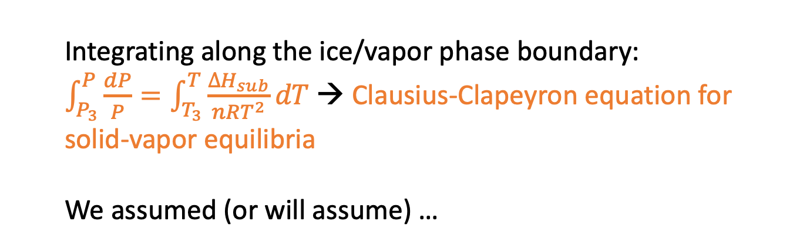
Separating variables in preparation for integrating Clapeyron
Clapeyron: $dP=\frac{∆H_{trs}}{T∆V_{trs}}dT$
P
Integrating along the ice/vapor phase boundary:
$\int_{P_{3}}^{P}{\frac{dP}{P}}=\int_{T_{3}}^{T}{\frac{∆H_{sub}}{nRT^{2}}dT}$ → Clausius-Clapeyron equation for solid-vapor equilibria
We assumed (or will assume) …
T

Slide 8
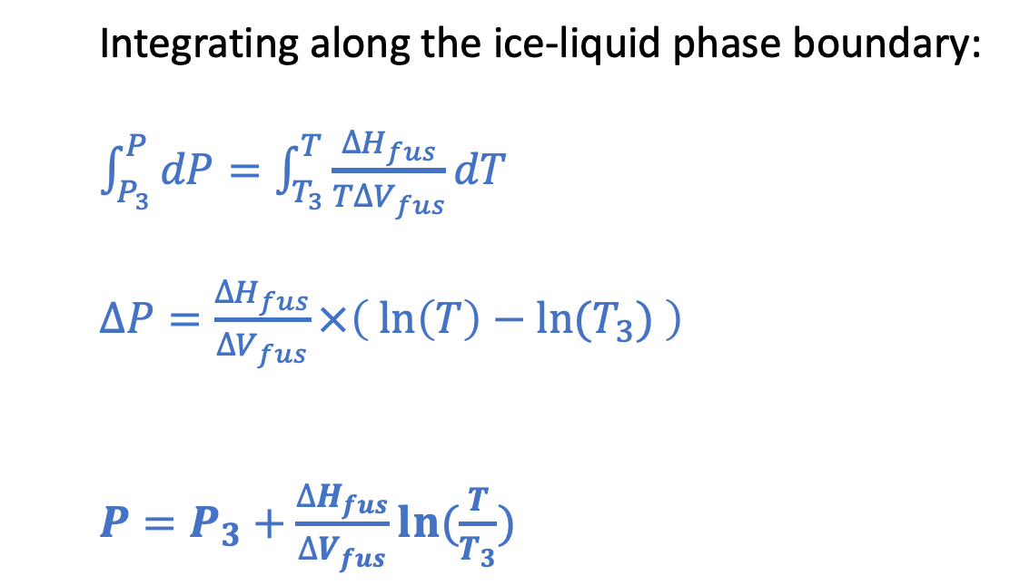
Thomson (for the ice-liquid phase boundary)
P
Integrating along the ice-liquid phase boundary:
$\int_{P_{3}}^{P}{dP}=\int_{T_{3}}^{T}{\frac{∆H_{fus}}{T∆V_{fus}}dT}$
$∆P=\frac{∆H_{fus}}{∆V_{fus}}×\left(\ln\left(T\right)−ln⁡(T_{3}) \right)$
$P=P_{3}+\frac{∆H_{fus}}{∆V_{fus}}ln⁡(\frac{T}{T_{3}})$
T

Slide 9
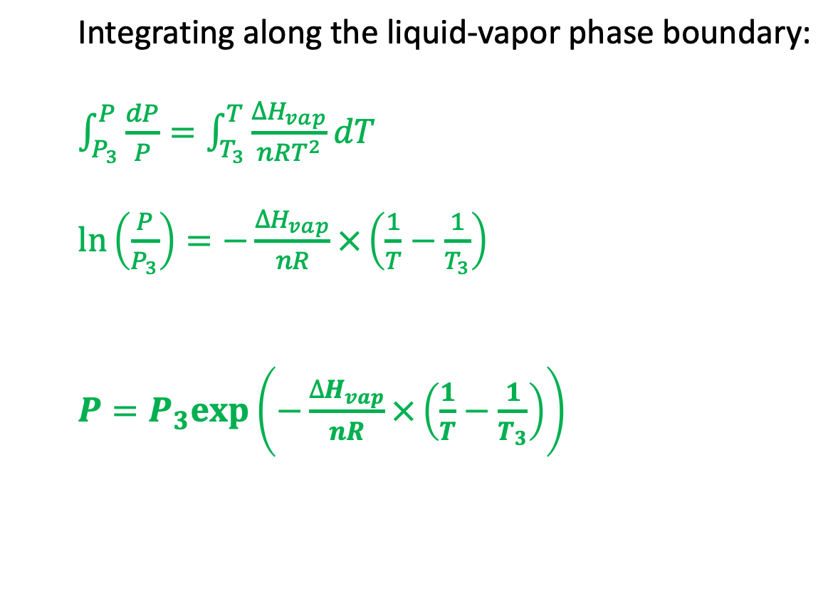
Clausius-Clapeyron (for the liquid-vapor phase boundary)
P
Integrating along the liquid-vapor phase boundary:
$\int_{P_{3}}^{P}{\frac{dP}{P}}=\int_{T_{3}}^{T}{\frac{∆H_{vap}}{nRT^{2}}dT}$
$\ln\left(\frac{P}{P_{3}}\right)=−\frac{∆H_{vap}}{nR}×\left(\frac{1}{T}−\frac{1}{T_{3}}\right)$
$P=P_{3}exp⁡\left(−\frac{∆H_{vap}}{nR}×\left(\frac{1}{T}−\frac{1}{T_{3}}\right)\right)$
T

Slide 10
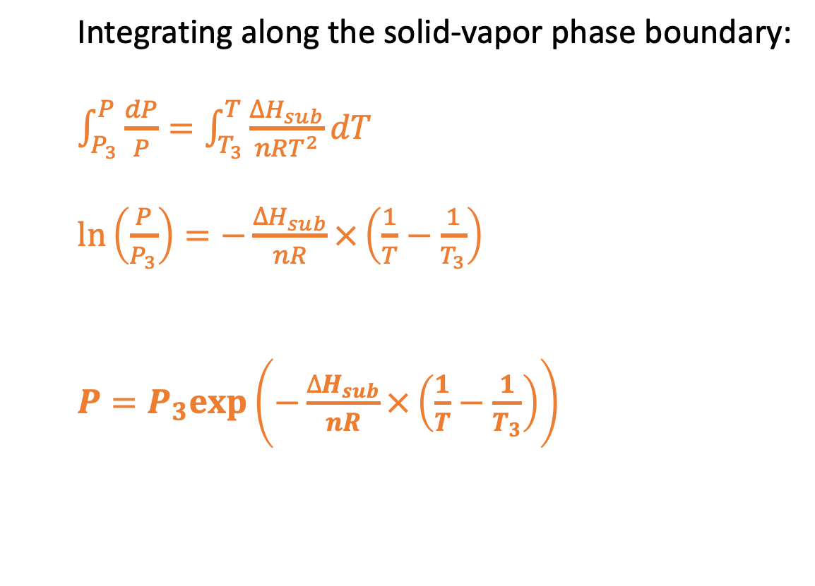
Clausius-Clapeyron (for the solid-vapor phase boundary)
P
Integrating along the solid-vapor phase boundary:
$\int_{P_{3}}^{P}{\frac{dP}{P}}=\int_{T_{3}}^{T}{\frac{∆H_{sub}}{nRT^{2}}dT}$
$\ln\left(\frac{P}{P_{3}}\right)=−\frac{∆H_{sub}}{nR}×\left(\frac{1}{T}−\frac{1}{T_{3}}\right)$
$P=P_{3}exp⁡\left(−\frac{∆H_{sub}}{nR}×\left(\frac{1}{T}−\frac{1}{T_{3}}\right)\right)$
T

